Slide 1

HCI - Assignment n.2
Design and prototyping of an application using a human-centered approach
Final Presentation and Demo
Project Title: BetWallet - An application for controlling betting money
Group: Daniel Francisco, Luís Martins and Pedro Jorge
Lab Class: P6
HCI 2020-2021

Slide 2

Introduction
BetWallet
BetWallet is an app designed for helping in the management of money won/spent through betting.
Why this project?
We used to casually bet, however, we have never found an app with a simple interface and easy to use where we could manage our bets.
That's why this app was designed: to help everyone manage their betting money easily and have that information stored in one app
HCI 2020-2021
‹#›

Slide 3

Project Objectives
BetWallet
Define high-level goals.
Show information of the user´s profits, losses and current budget;
Show information of the user’s daily spending money on bets in an organized and easy-to-follow way;
Set a monthly limit of money to spend, preventing the user from overspending their budget;
Have a “user-friendly” interface so that everyone can easily use the application, from professional bettors to bettors who only place bets from time to time.
What are the expected outcomes?
Decrease the amount of money the user spends over their budget;
Help the user understand if they are losing way too much money to keep betting;
What are the benefits?
Have all of the user's betting expenses in one app, allowing the user to not misjudge his expenses.
Able to share bets with whoever the user wants.
HCI 2020-2021
‹#›

Slide 4


Personas
BetWallet
Persona: BetWallet user
Fictional Name: Nuno Matreiro
Job title/ Major responsibilities: Unemployed
Demographics: Born and raised in Chaves, Portugal
25 years old
Single
Education: Bachelor's degree in Mechanical Engineering
Goals and Tasks: Consulting his betting expenses
Consulting his current budget and monthly results
Environment: Uses his phone to register his bets and know how much money he is earning/losing. He is a bettor who only bets from time to time and is trying to gather enough money to go on a trip abroad.
HCI 2020-2021
‹#›

Slide 5

Personas
BetWallet
Persona: BetWallet user
Fictional Name: Manuel Baptista Rodriguez
Job title/ Major responsibilities: Erasmus Student
Demographics: Born and raised in Medellín, Colombia
19 years old
Married
Education: Bachelor's degree in Civil Engineering
Goals and Tasks: Share bets with his friends
Consulting his current budget and monthly results
Set a monthly limit of money to spend
Environment: Uses his phone to register his bets and share them with his friends. He is a professional bettor and he is gathering money to buy a new phone for his wife.
HCI 2020-2021
‹#›

Slide 6
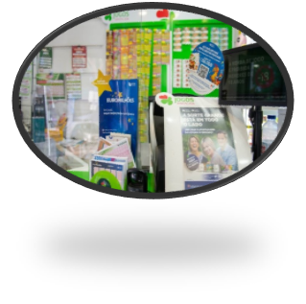

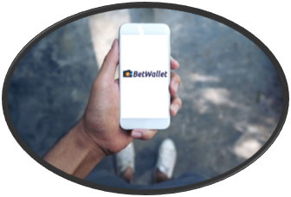
Scenario 1 - Register a bet
BetWallet
Nuno Matreiro just placed a bet on a nearby kiosk
He wants to register his bet to keep track of his expenses
To achieve his goal, he opens the BetWallet app and registers his bet
HCI 2020-2021
‹#›

Slide 7
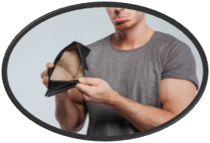

Scenario 2 - Set monthly limit
BetWallet
Manuel Rodriguez thinks he’s been spending too much money on betting
He wants to set a limit to how much money he spends on betting every month
To achieve his goal, he opens the BetWallet app and sets a monthly limit
HCI 2020-2021
‹#›

Slide 8
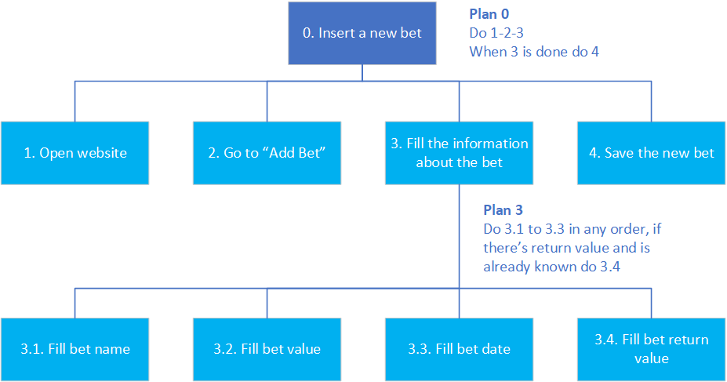
Tasks
BetWallet
Scenario 1
Insert the new bet information into the app, without the app this would have to be done on paper or on a plain text editor
HCI 2020-2021
‹#›

Slide 9
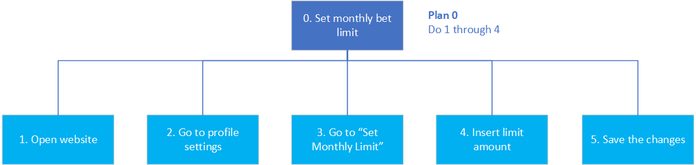
Tasks
BetWallet
Scenario 2
Set a monthly limit for how much money is spent on betting
HCI 2020-2021
‹#›

Slide 10

Requirements
BetWallet
Functional requirements
Register bets, indicating its details;
Option to set a monthly limit of money to spend;
Verify if the amount the user is betting won’t exceed the monthly limit;
Share bets with friends;
Calculate total amount of money spent;
Calculate total amount of money won;
Show stats for money spent and won during a certain month.
HCI 2020-2021
‹#›

Slide 11
Requirements
BetWallet
Non-functional requirements
Intuitive interface for tracking betting expenses;
Easy to find monthly limit option;
Easy to find add bet button;
When registering, the user has to be 18 years old or older to use the app;
Accessible at any time.
HCI 2020-2021
‹#›

Slide 12
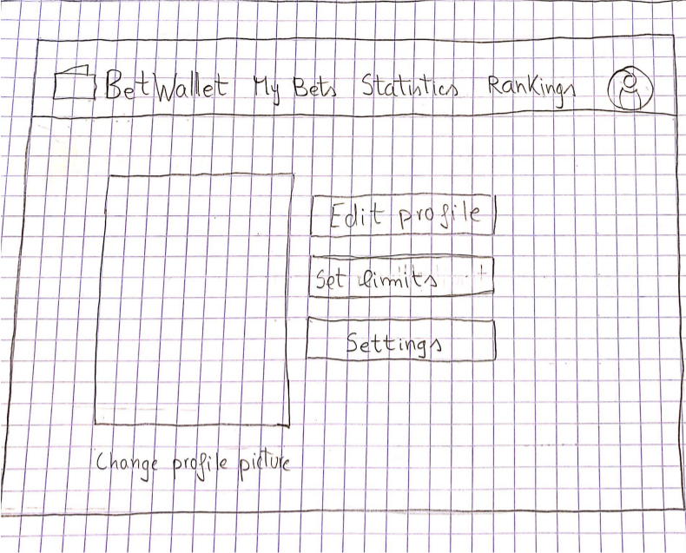
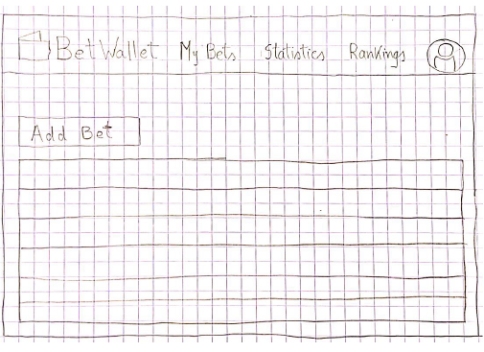
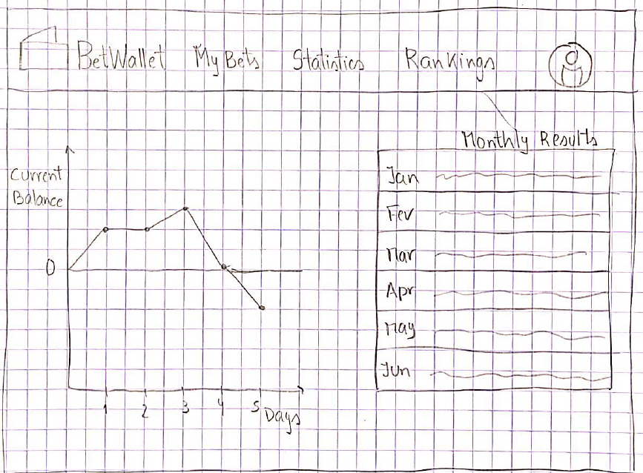
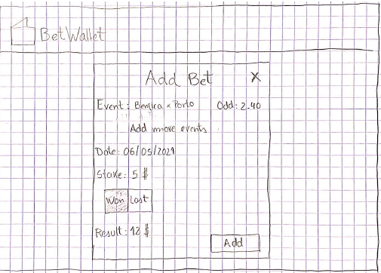
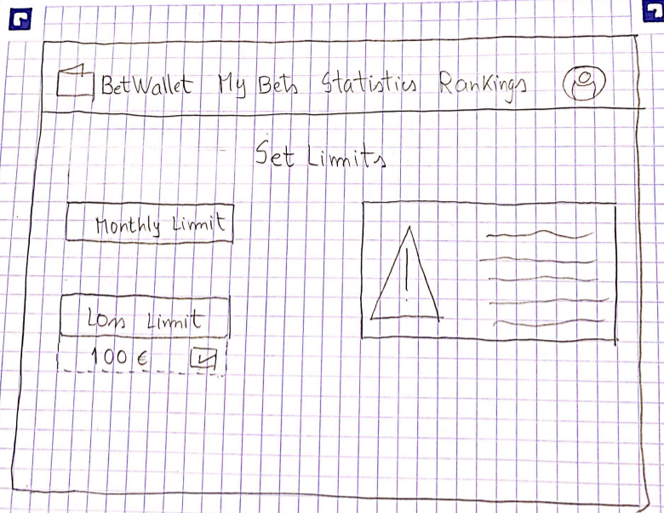
Low Fidelity Prototype(LFP)
BetWallet Tests
Add a bet 2. Set Monthly Limit 3. Check Statistics of a month
HCI 2020 - 2021
‹#›

Slide 13




LFP User Evaluation
BetWallet Results
7 participants(5 male,2 female);
Average age: 20 years old;
We wanted to:
C - Check if the interface was simple and easy;
- Count how much time the users took to finish the tasks.
Mostly positive feedback;
Participants noted it was not immediately intuitive where to set the monthly limit.
Participants confused by the purpose of the “Rankings” page.
HCI 2020 - 2021
‹#›

Slide 14


Platforms Used
BetWallet
The software used was HTML, JS and CSS;
The IDLE used was Visual Studio Code;
Main reasons why we used these technologies:
Was recommended to us, following installation problems with Angular.
VS Code has a very simple interface.
HCI 2020 - 2021
‹#›

Slide 15
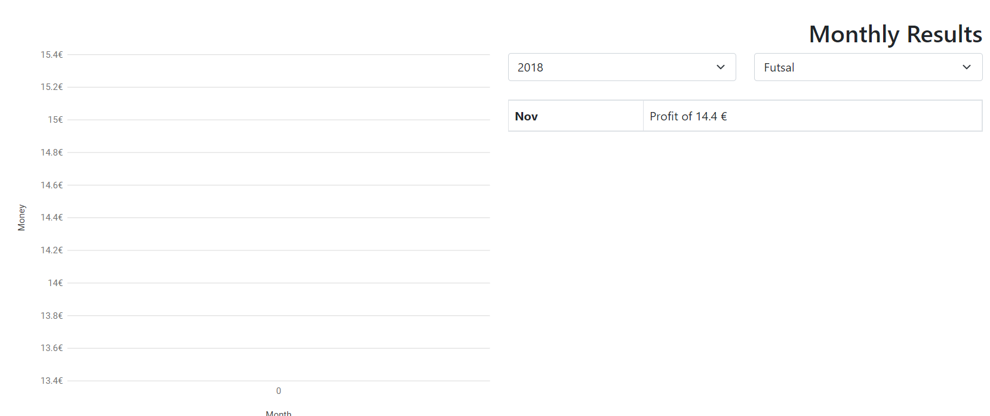
Development problems
BetWallet
Graph Limitations
When trying to see the statistics of a certain month and sport, the graph would not appear
HCI 2020 - 2021
‹#›

Slide 16
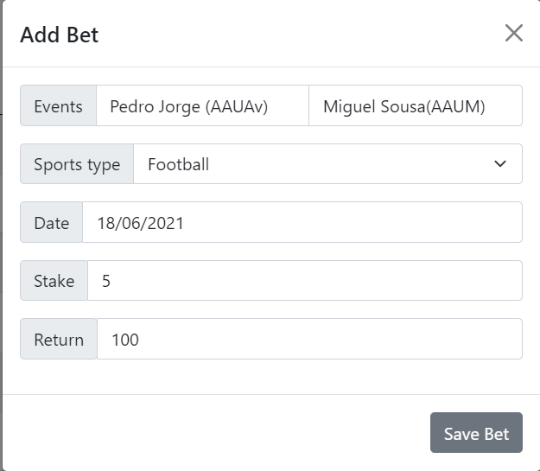
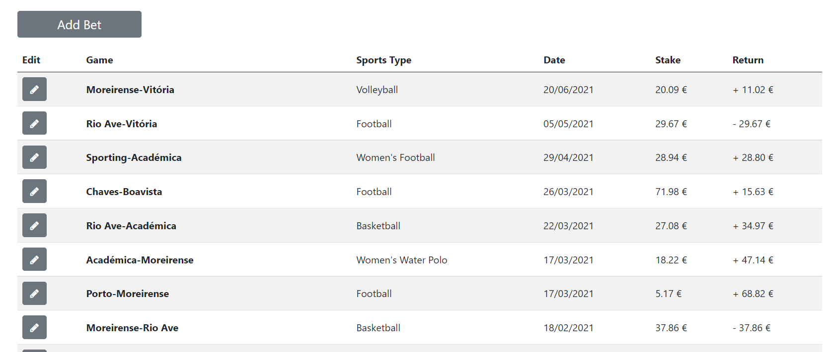
Development problems
BetWallet
Problems with adding bets
Bet from 18/06 is not showing because there is a bet with a most recent date
HCI 2020 - 2021
‹#›

Slide 17
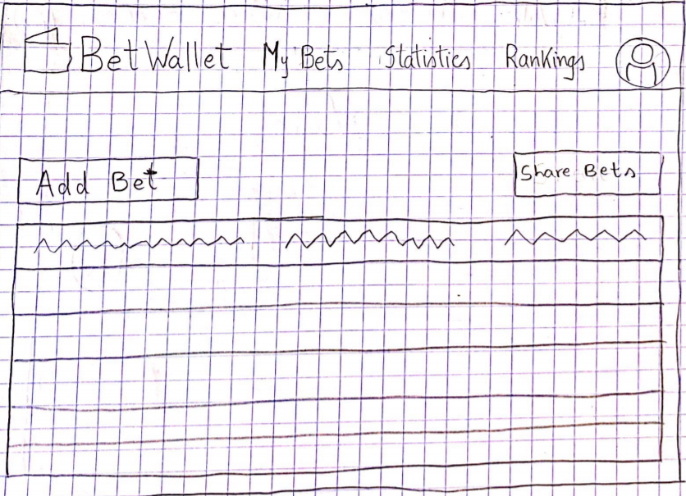
Development problems
BetWallet
Sharing bets with friends not implemented
HCI 2020 - 2021
‹#›

Slide 18
User Evaluation of the
Functional Prototype
(Procedure)
BetWallet
9 people participated in this evaluation.
Each person had to perform 6 tasks and at the end of each one give feedback, on a scale from 1 to 5, how hard it was to complete the task.
The tasks given were:
Add a new bet to your bets with todays date;
Find your newest bet and change the sports type to women’s water polo;
Check your most recent monthly statistics;
Check last year’s football statistics;
Find the day where you lost more money in that year;
Set a monthly limit of 100 €.
The observer took notes on the mistakes made by the participant with the objective of improving the application.
HCI 2020 - 2021
‹#›

Slide 19
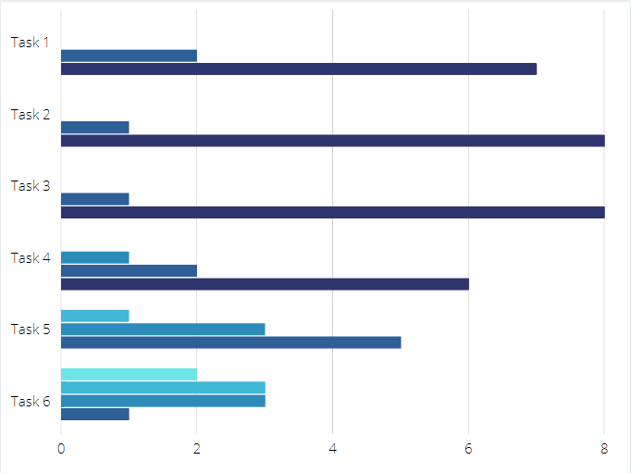
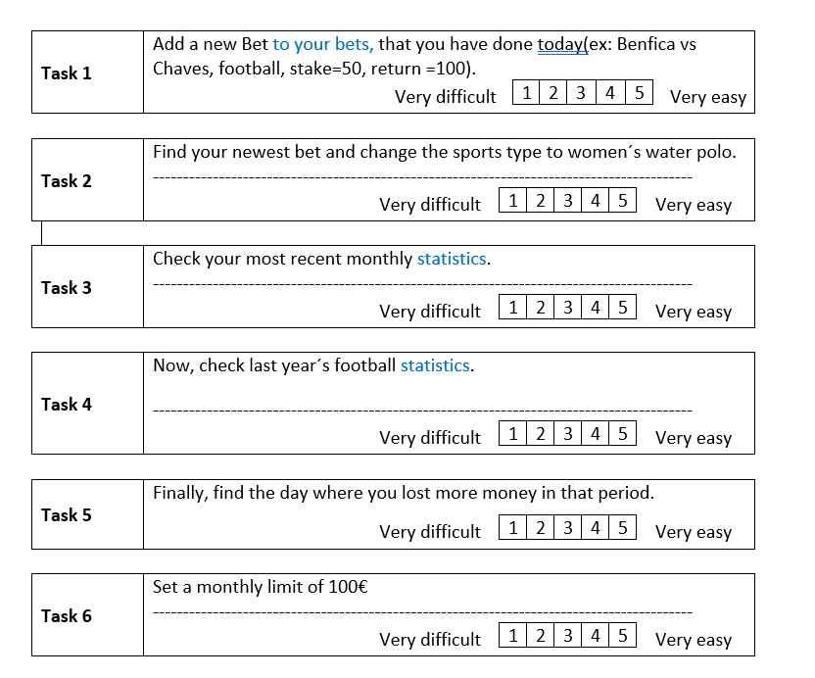
User Evaluation of the
Functional Prototype
(Results)
BetWallet
Very Difficult
Very Easy
HCI 2020 - 2021
‹#›

Slide 20
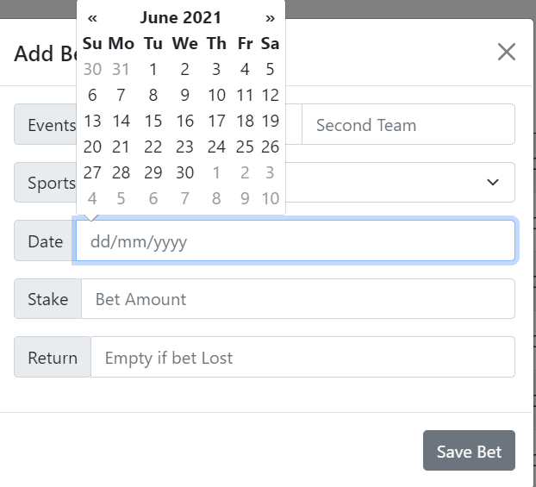
User Evaluation of the
Functional Prototype
(Changes)
BetWallet
Noted on task 1 that the format to add a date was too complicated.
BEFORE
AFTER
HCI 2020 - 2021
‹#›

Slide 21
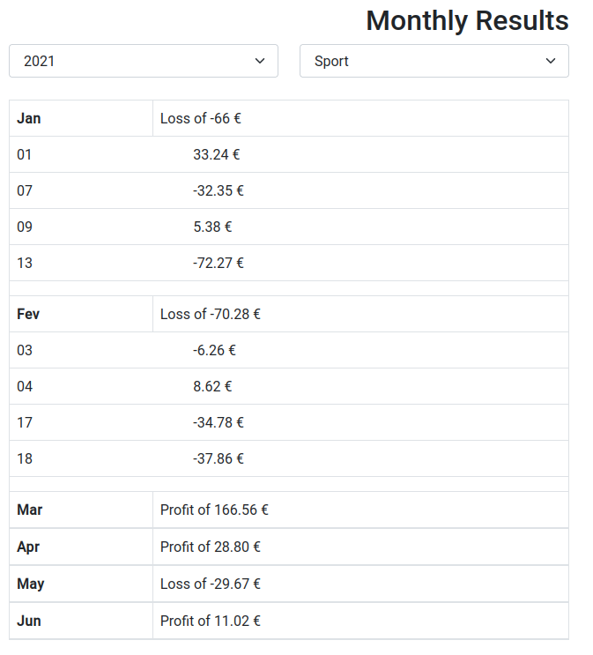
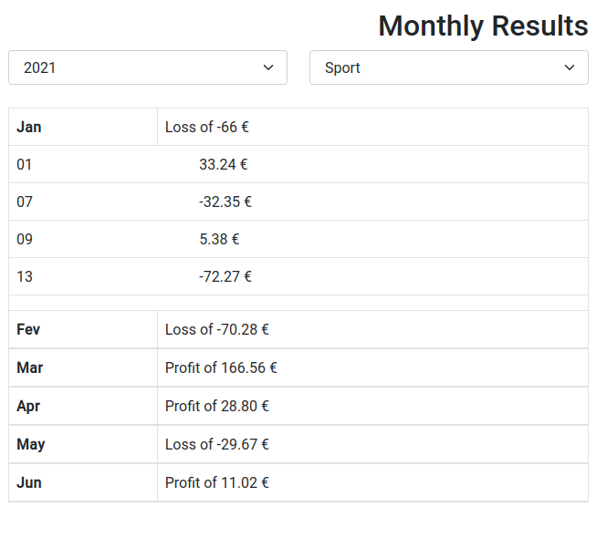
User Evaluation of the
Functional Prototype
AFTER
BetWallet
It was hard to find the day where you lost more money.
BEFORE
HCI 2020 - 2021
‹#›

Slide 22
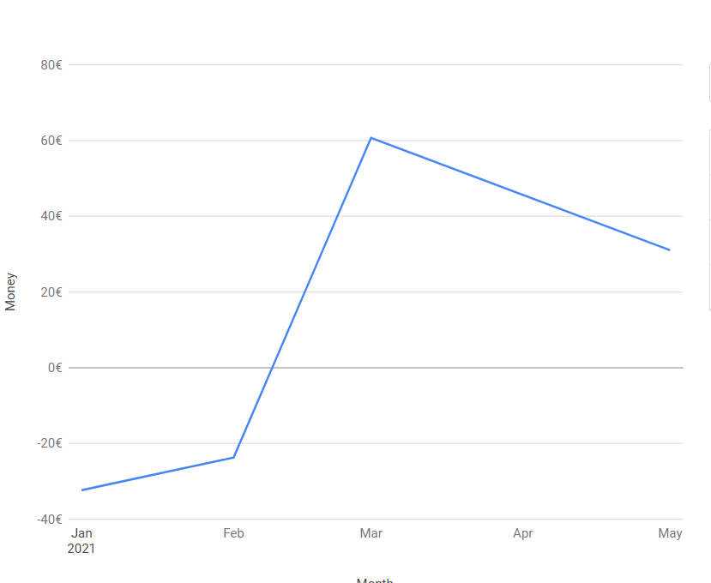
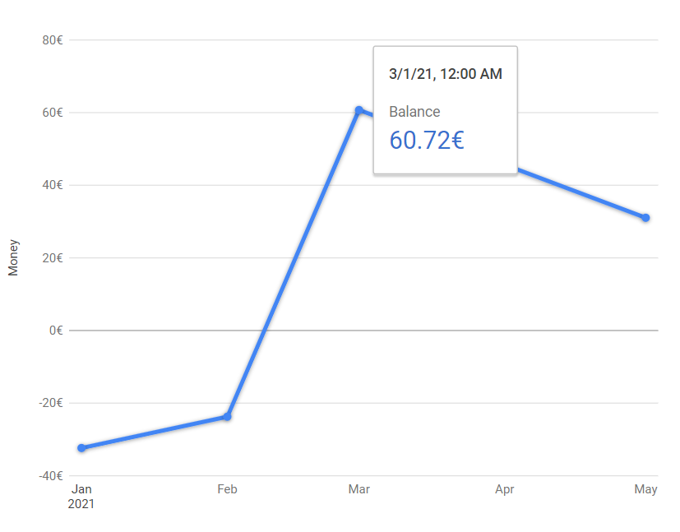
User Evaluation of the
Functional Prototype
BetWallet
There were no units on the graph and couldn’t see values directly on the graph.
BEFORE
AFTER
HCI 2020 - 2021
‹#›

Slide 23
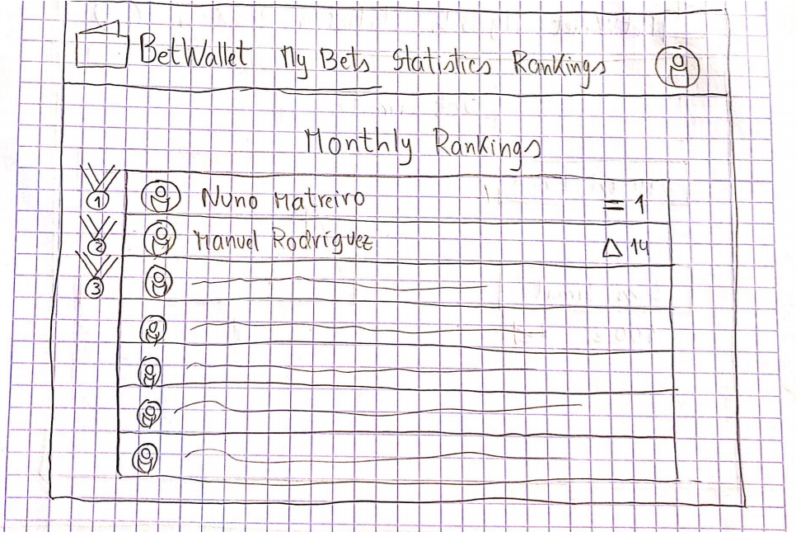
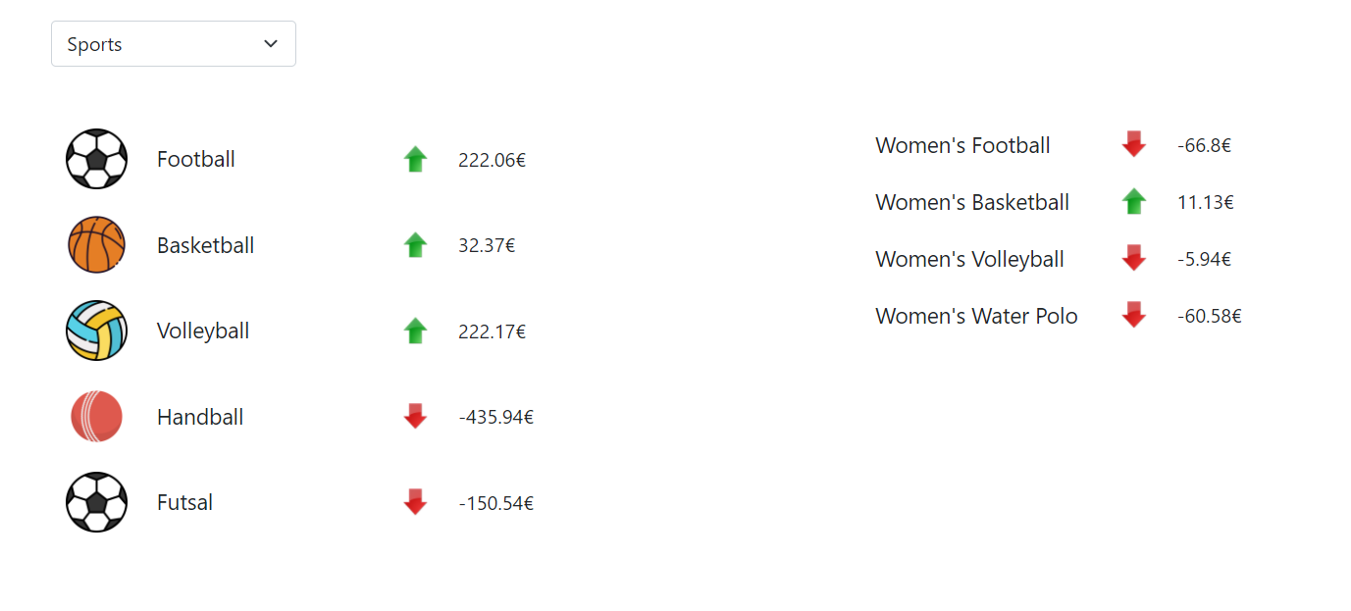
User Evaluation of the
Functional Prototype
BetWallet
Rankings page didn’t have a good purpose.
BEFORE
AFTER
Note: By the time of the user evaluation of the functional prototype, we did not have the Rankings page functional, this was our low-fidelity prototype of the page
HCI 2020 - 2021
‹#›

Slide 24
Demo
BetWallet
A demonstração da aplicação será feita na apresentação
HCI 2020 - 2021
‹#›

Slide 25
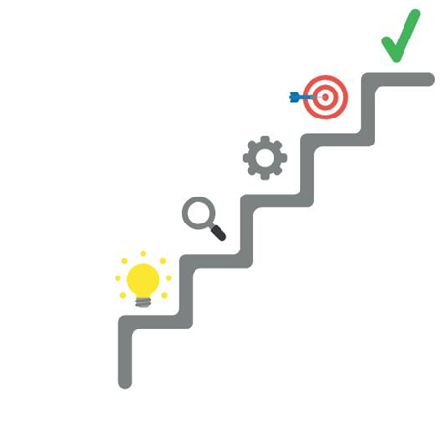
Future Work
BetWallet
Implement Login Authentication;
Implement the option to share bets with friends;
Develop the “Profile” tab (change name, hobby, occupation, etc.);
Effort of each group member
Same effort for all
HCI 2020 - 2021
‹#›

